Slide 1


In-depth analysis of Airbnb
Searching made easy

Slide 2



Our goal
With the help of analytics, we want to cater to the following:
compare
help
suggest
the price and other features of the listings in San Francisco, Los Angeles & San Diego
travelers choose a good listing within their price range
on listing price for the hosts by listings with similar features

Slide 3



Process Flow
Data Management
Building in-house tool
Extracting key information
Provide Monthly and Weekly Recommendations
Providing price point recommendations to property owners
Data gathering
Cleaning the data
Providing an open-source tool for users to find appropriate listings
Exploratory Data Analysis
Price Predicting Model

Slide 4

1. Data Management

Slide 5
Our Data Source
data source: http://insideairbnb.com/
listings
Listings data with 74 features of each of the listings.
Features we used for analysis: name (continuous), neighbourhood_cleansed (textual), price (numerical), property_type (categorical), amentities (categorical), etc
calendar
Details about price and availability of each listing in the next years. Includes 7 attributes such as date, price and availability
reviews
Reviews of the listings given by its guests. Includes 6 attributes such as date, reviewer name and comments

Slide 6



Data Size
20+ Million
1.5+ Million
38,544
Pricing across date
Customer Reviews
Listings
Across three cities
Across SF, SD & LA
In three cities, every date

Slide 7

2. Exploratory Data Analysis

Slide 8




Our Findings will focus on:
Spatial Data Analysis of
Los Angeles
San Francisco
San Diego
Demand and Price Analysis of San Diego
Word Cloud of Reviews Data of San Diego

Slide 9
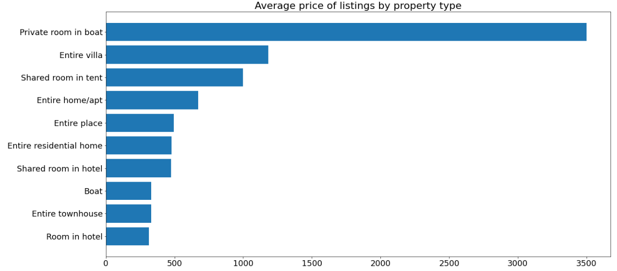
San Diego

Slide 10
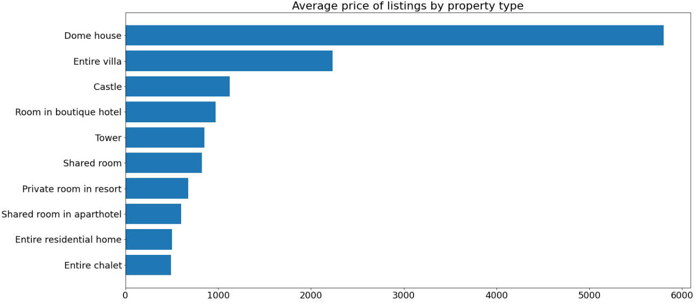
Los Angeles

Slide 11
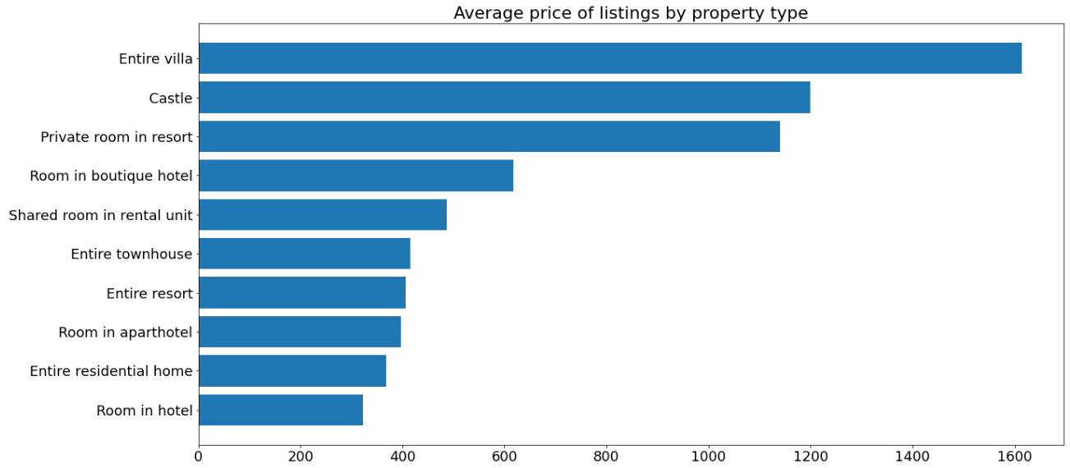
San Francisco

Slide 12
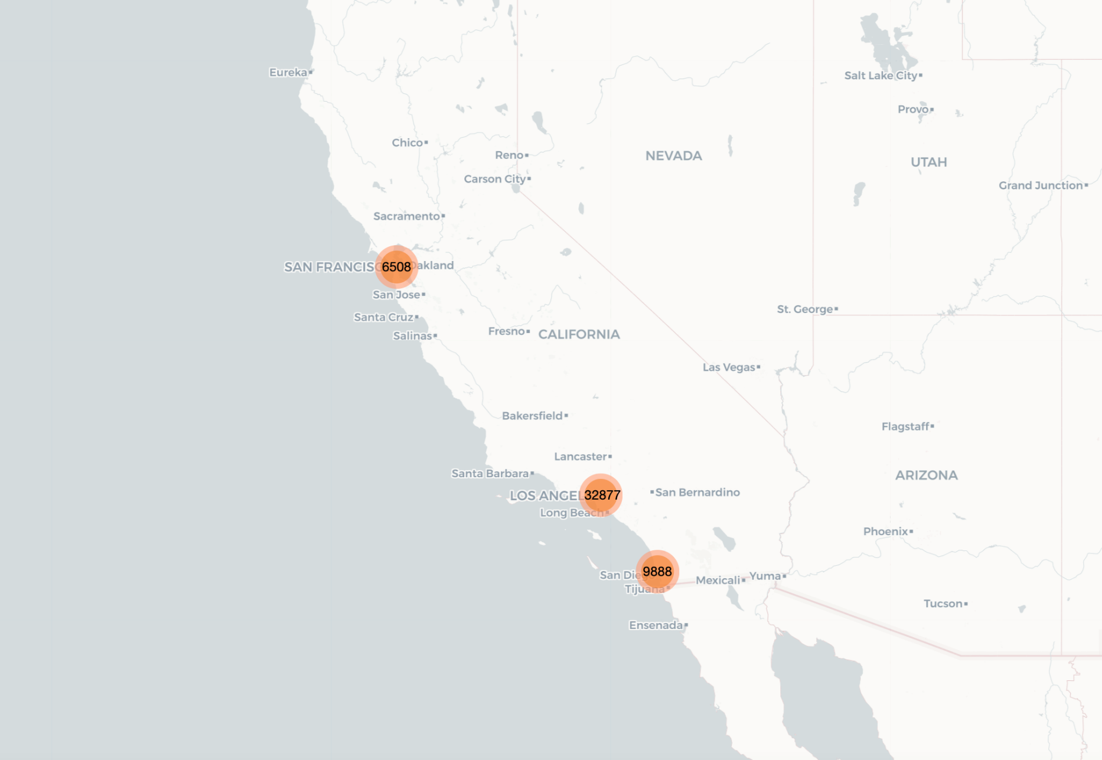
Spatial Data Analysis of Three Cities
Click Me!
Notes:
This is the basic interactive graph with all the listing in San Francisco, San Diego and Los Angeles appearing in a clustered fashion. You can click on clusters to see the listing it comprises, including details like Listing Name, Host Name, Price of the property, Property Type, Room Type. This visualization helps to explore every listing geographically. It gives the overall sense of how the listings are distributed across neighborhood. We can see from the map that maximum listing are clustered around Los Angeles, followed by San Diego, and the least number of listing are in San Francisco.

Slide 13



Average Price per Night Comparison
$260.5
$253.7
Los Angeles
San Francisco
$267.7
San Diego

Slide 14
San Diego
Demand across year and month
Demand & Price
Analysis
Price across year and month
Average prices by day of the week
Whether prices of listings fluctuate with demand?
Notes:
Next, we will focus San Diego’s data, for the very reason that we live in San Diego and second, so we wish to perform an in-depth analysis on it.

Slide 15
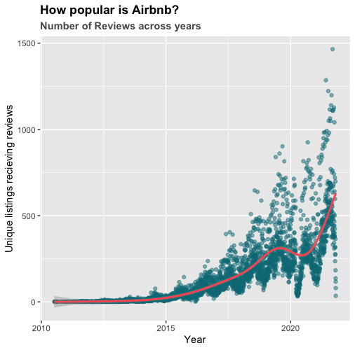
How popular has Airbnb become in San Diego?
Notes:
We will look at demand over the years since the inception of Airbnb in 2010 and across months of the year to understand seasonlity. We also wish to establish a relation between price and demand. The question we aspire to answer is whether prices of listings fluctuate with demand. We will also conduct a more granular analysis to understand how prices vary by days of the week.
To study the demand, since we did not have data on the bookings made over the past year, we will use ‘number of reviews’ variable as the indicator for demand. As per Airbnb, about 50% of guests review the hosts/listings, hence studying the number of review will give us a good estimation of the demand.
1.The number of unique listings receiving reviews has increased over the years. We can see an almost exponential increase in the number of reviews, which as discussed earlier, indicates an exponential increase in the demand.
2. Notably, year 2020 saw a significant decline, we infer that it is the result of covid pandemic. Affected by the epidemic, people tend to stay at home instead of traveling, which reduces airbnb bookings
2.One can observe that number of reviews/demand also depicts a seasonal pattern. Every year there are peaks and drop in the demand, indicating that certain months are busier compared to the others.
Let us look at monthly demands for each of the years starting from 2019.

Slide 16
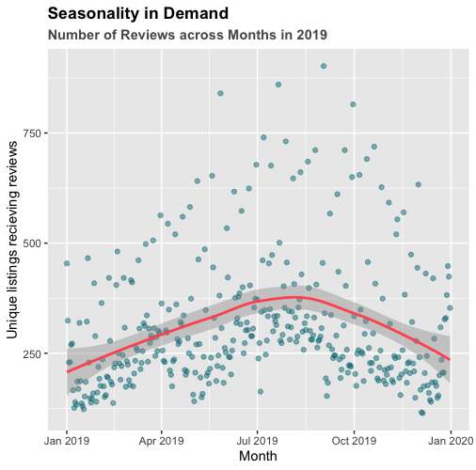
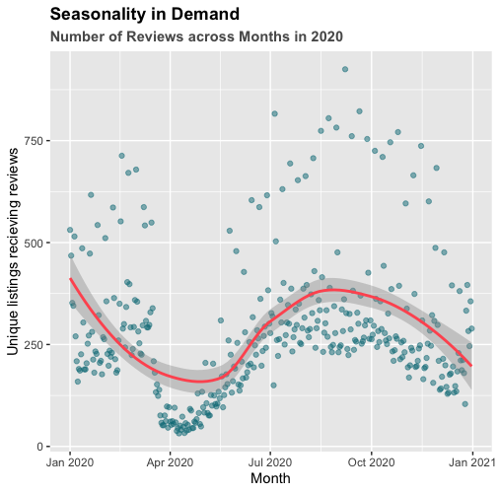
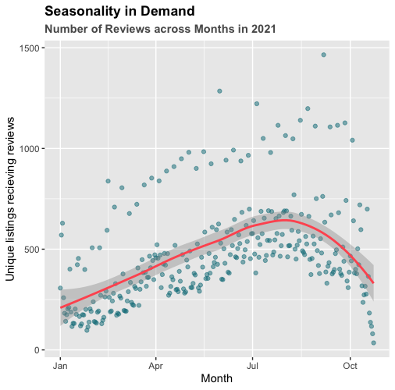
Seasonality in Demand
Notes:
The dots in the graphs reflect the number of reviews written on a particular date, which as our assumption reflects the demand.
There seems to be a general pattern in how demand fluctuates across the year. The demand is usually lowest in January and increases until August, when it begins to falls until the end of the year. We inferred that this could possibly be due to the holiday season kicking in, with people celebrating Thanksgiving and Christmas at home with their family, leading to a slump in tourism and hence the demand for tourist lodging.
But in 2020, the pattern is quite different, which fluctuates across the year. The demand continues to fall since the beginning of the year. After reaching the bottom in May, it begins to increase and peaks in August, then falls again. As mentioned before, we inferred that this could result from the outbreak of covid pandemic in the beginning of 2020.

Slide 17
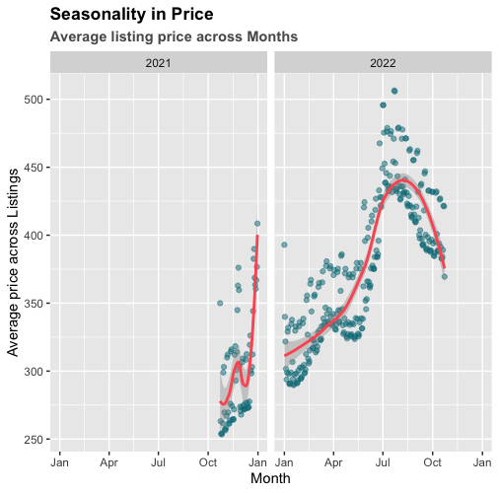
How is Airbnb priced across the year?
Notes:
After observing the pattern in the demand, we wanted to investigate whether the prices of the listings follow a similar pattern. We looked at the daily average prices of the listings across the years using the data from the calendar table.
The average prices across listings tends to increase as one progresses along the year and spikes in August. The pattern is similar to that of the number of reviews/demand. This seems intuitive as in most cases, the price to decrease with a decrease in demand.
We can also see two sets of points on the above charts which depicts that average prices on certain days were higher compared to the other days. Following, we will plot a box plot of average prices by day of the week to understand this phenomenon.

Slide 18
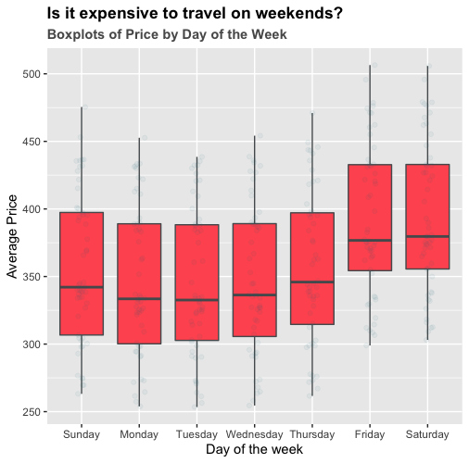
Average Prices by Day of The Week
Notes:
As we can see, Fridays and Saturdays are more expensive compared to the other days of the weeks, perhaps due to higher demand for lodging.

Slide 19
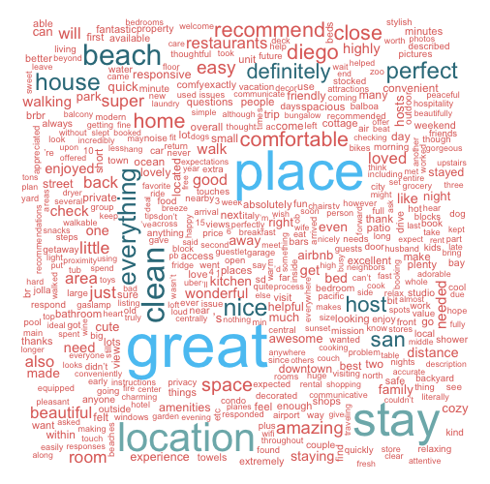


Customers’ Reviews Word cloud
Analysis By Word
Notes:
Let us start first with looking at the dominant themes in the reviews. Wordclouds take a frequency count of the words in the corpus as input, and return a beautiful display of dominant (frequently occurring) words, with their size being proportional to their relative frequency.
An analysis of the word cloud shows interesting trends; Location seems to be key, since the words “place”, “location”, “beach” are featured prominently in the word cloud. Adjective like “clean”, “great”, “nice” also find frequent mention, indicating that customers lay much emphasis on the living environment of the house. Availability of “Restaurants” close by find mention too. The word “Host” finds a lot of mention; indicating the important role that hosts play in shaping the Airbnb experience.

Slide 20

3. Building an in-house tool

Slide 21
An open-source tool to help individuals compare prices
Building a tool to help you select the best
Find neighborhood with the best sentiment
Compare between cities in California

Slide 22

Let’s go to the interactive tool
Click Me

Slide 23

4. Price Predicting Model

Slide 24

Some variables had little value to predicting price in advance as they could not be known in advance.
Problems
Many variables needed to be transformed and certain variables discarded because of missing values.
Some of the variables after modelling did
not make sense as they were statistically
insignificant.

Slide 25
$ 68.04
San Francisco
$ 71.37
Los Angeles
Performance
$ 74.65
San Diego
Our Model
RMSE on Validation
Set
Transformed amenities, neighborhood, property type into categorical variables.
Split the data into train and validation set (75:25)
Built a baseline using average price from the train set
Trained a Linear regression and a Random Forest regressor.
Number of Bedrooms
Latitude & Longitude
Minimum Nights
Total customers the stay can accommodate
Availability in a calendar year
Important Features
Common amongst
Top 10 features
Random Forest
Best Model

Slide 26
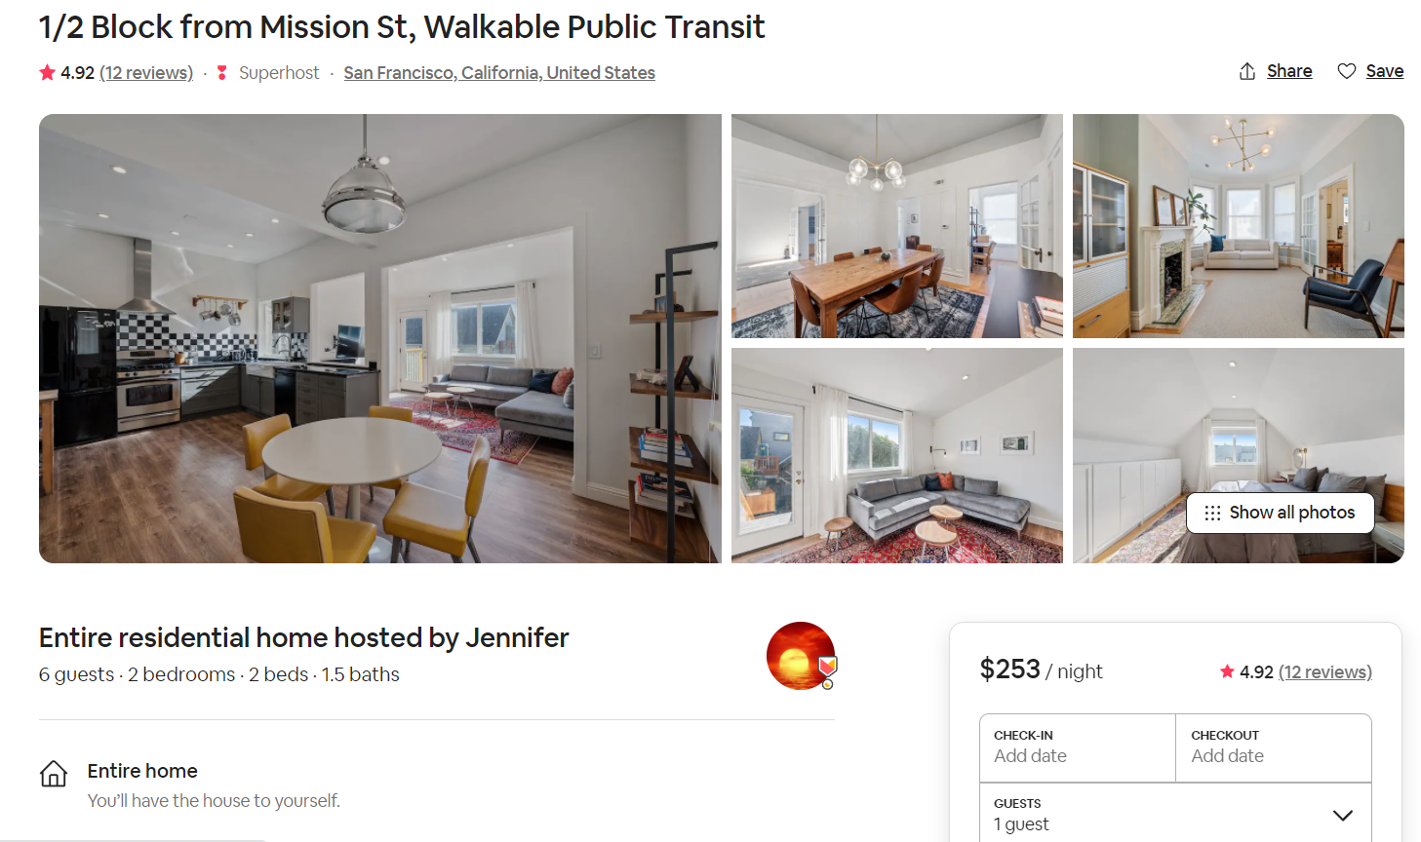
SAN FRANCISCO
Our Prediction
$ 284.17

Slide 27
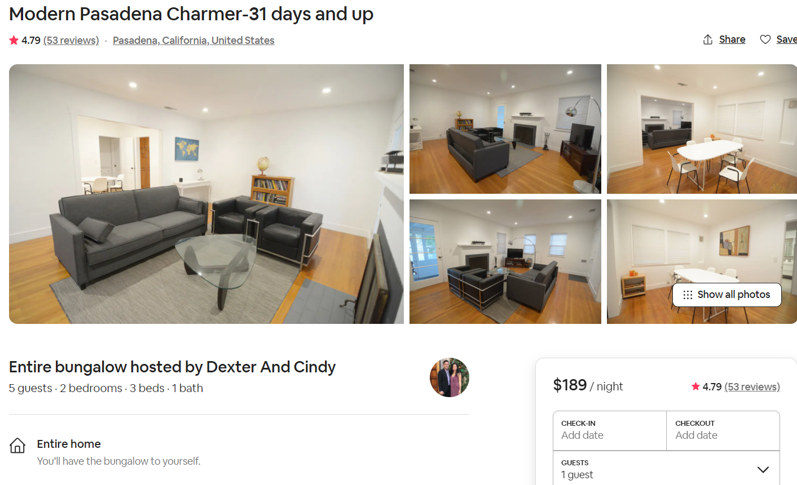
LOS ANGELES
Our Prediction
$ 156.09

Slide 28
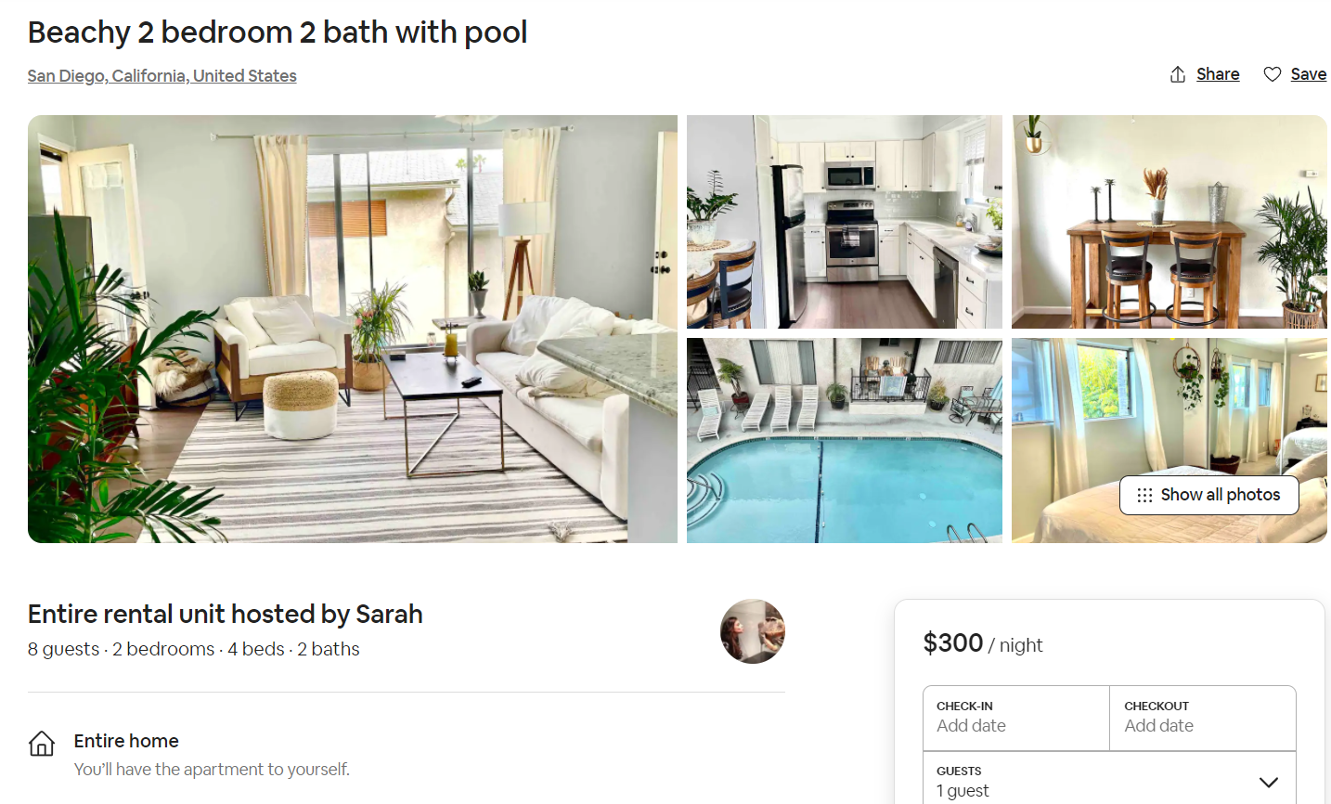
SAN DIEGO
Our Prediction
$ 260.24

Slide 29
Final Recommendations
We intend to help both the customers as well as property owners through their journey of Airbnb
Save Money, Choose Wisely
Find the suited listing
For property owners
Book during the weekdays
Months June, July & August
are the costliest
Use our tool to choose
the best listings according
to your preferences
Use our prediction
model to appropriately
price your listing

